Slide 1
OGC API Hackathon 2019
London, United Kingdom
20 June 2019

Slide 2
Day 1 – Thursday 20 June 2019
09:00hrs - Welcome note (Geovation Hub Staff)
09:15hrs - Goals and objectives (OGC DKM & SWG Chairs)
09:30hrs - Introduction to the Draft Specifications (Common, Features, Map Tiles, Processes, Coverages)
11:00hrs – Split into teams by specification
11:10hrs – Team-based work starts [define the problem/scope]
12:30hrs - Lunch
13:30hrs - Resume [come up with multiple options]
17:00hrs - Early Dinner
18:00hrs - Resume [select the preferred option]
20:00hrs - Back-briefs from each team
21:00hrs - Adjourn

Slide 3
Day 2 – Friday 21 June 2019
08:00hrs - Goals and objectives (OGC DKM & SWG Chairs)
08:30hrs - Resume team-based work [implement the preferred option]
12:00hrs - Third back-briefs from each team [ "alignment report" to brief on any deviation from Core as provided at start]
12:30hrs - Working Lunch [complete implementation of the preferred option]
13:30hrs – Joint work on Common or Resume team-based work [implement the preferred option]
14:30hrs – Show & Tell (Demonstration of clients accessing services)
15:30hrs - Final back-briefs
16:30hrs - Closing note (OGC COO)
17:00hrs - Close

Slide 4

Goal & Objectives
Goal
To advance the development of OGC API specifications
Objectives
Develop, deploy and test services/clients that support OGC APIs
Suggest improvements for a common core
Define rules/guidance that can be documented
Validate work that has been completed to date
Contribute to the GitHub repos

Slide 5
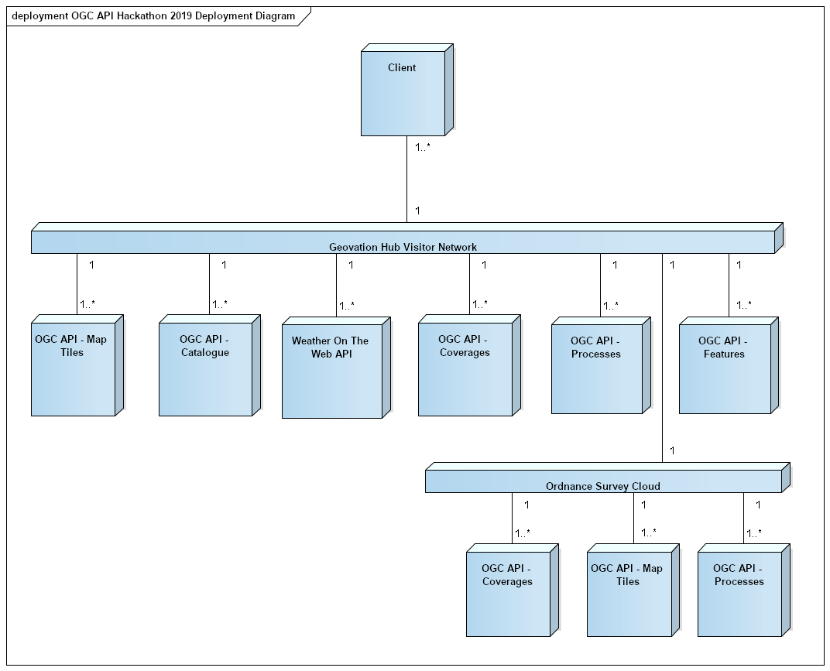
Architecture

Slide 6
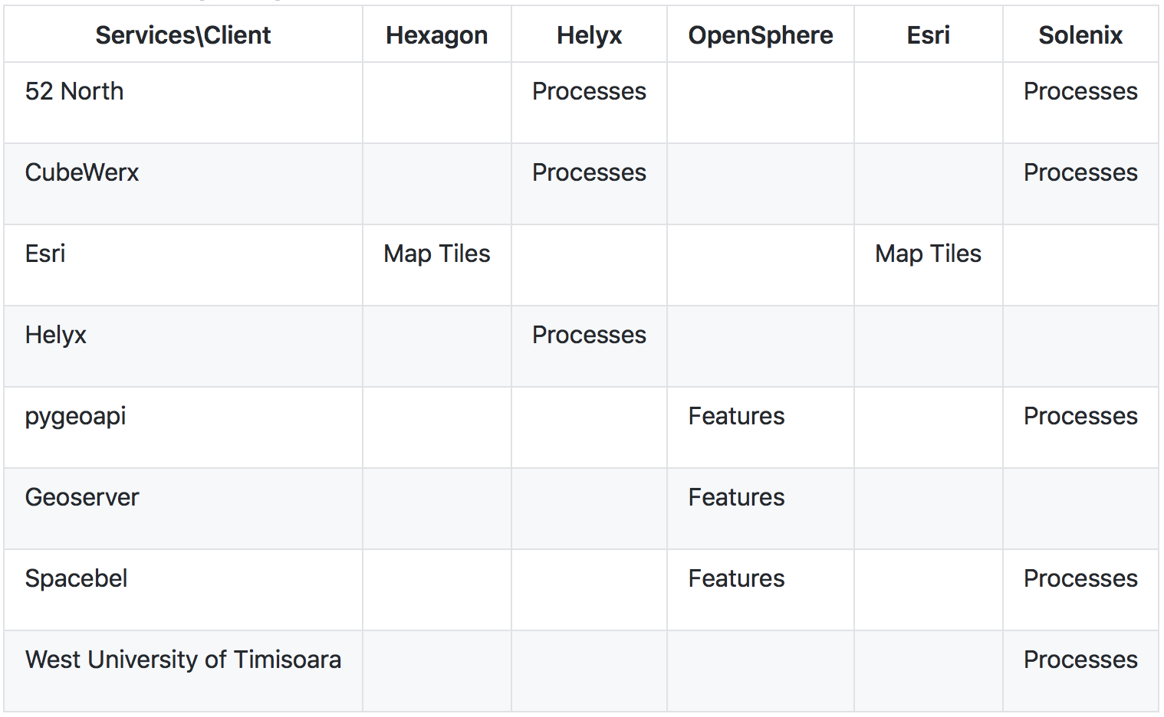
Technology Integration Experiments (TIE)
Let me know if your service or client is missing

Slide 7
Reflective Summary
Developed, deployed and tested services/clients that support OGC APIs
Suggested and made several improvements to the common core
Defined rules and designed guidance for documentation in the specification
Validated work that has been completed to date
Contributed to the GitHub repositories

